Slide 1
Java Database Connectivity
(JDBC)

Slide 2
JDBC
• JDBC (Java DataBase Connectivity) - provides access to relational database systems
• JDBC is a vendor independent API for accessing relational data from different vendors (Microsoft Access, Oracle) in a consistent way
• The language SQL (Structured Query Language) is normally used to make queries on relational data
• JDBC API provides methods for executing SQL statements and obtaining results: SELECT, UPDATE, INSERT, DELETE etc.
• Provides portability (eliminates rewriting code for different databases and recompiling for different platforms) and faster, reusable object developing environment
• JDBC API is part of core Java; JDBC 1.O is bundled with JDK 1.1 or higher (package: java.sql) and JDBC 2.0 (needs compliant driver; additional package: javax.sql;

Slide 3
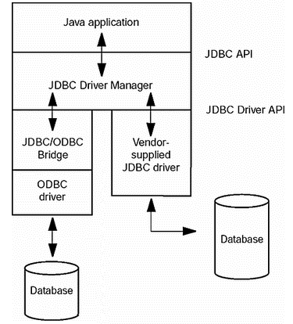
JDBC-to-database communication

Slide 4
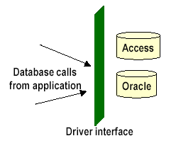
Vendor specific APIs - JDBC Drivers
• Database vendors provide proprietary APIs for accessing data managed by the server
• Languages such as C/C++ can make use of these APIs to interface with the database
• JDBC aims at providing an API that eliminates vendor specific nature in accessing a database
• However, JDBC still requires a vendor-specific driver for accessing database from a particular vendor
• The driver provides interface between JDBC API and vendor database by converting calls from JDBC API to vendor’s database calls
• With additional functionality of the driver, the same application may be reusable with a different vendor’s database by simply switching to that driver
• Example drivers:
- JDBC/ODBC driver: sun.jdbc.odbc.JdbcOdbcDriver (used in this course)
- Oracle driver: oracle.jdbc.driver.OracleDriver

Slide 5
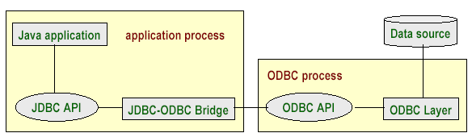

JDBC Driver Types
Type 1: JDBC-ODBC Bridge
• ODBC (Open Database Connectivity) is Microsoft’s API for SQL; popular on Windows platform
• ODBC API provides a set of functions for accessing a database
• JDBC drivers of this type translate calls from JDBC into corresponding ODBC calls

Slide 6
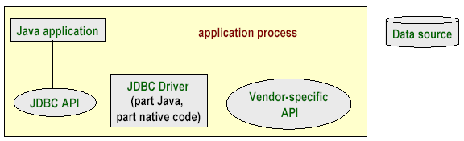
Type 2 - Part Java, Part Native Driver
JDBC driver consists of java code and native code which uses vendor-specific API for accessing databases
More efficient than JDBC-ODBC bridge due to fewer layers of communication
Typical of this type of driver is the driver provided by IBM for its DB2 Universal Database (UDB).

Slide 7
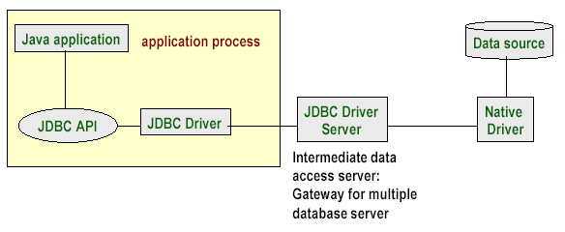
Type 3 - Intermediate Database Access Server
• An intermediate access server between client application and the data source acts as a gateway to connect to multiple database servers
• application sends JDBC calls to the intermediate server via JDBC driver
• The intermediate server handles the request using a native driver

Slide 8
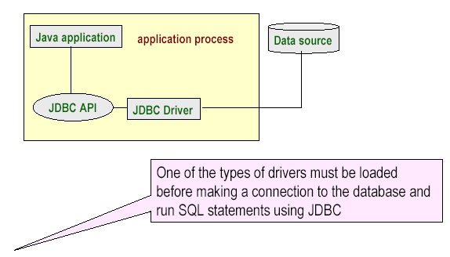
Type 4 - Pure Java Driver
• JDBC calls are directly translated to database calls specific to vendor
• very efficient in terms of performance and development time

Slide 9
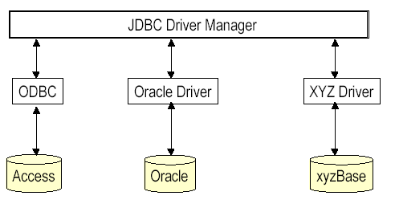
JDBC Driver Manager
• JDBC key components: DriverManager, Connection, Statement, ResultSet
• DriverManager handles communication with different drivers that conform to JDBC Driver API.
- The static class DriverManager manages the loaded drivers and contains methods for accessing connections to the databases

Slide 10
Four steps in creating a database application
Step 1: load a database driver
Step 2: make a database connection
Step 3: create and execute SQL statement
Step 4: process the result set, if necessary

Slide 11
Step 1: Loading a Driver
• A driver is always needed to obtain a connection
• Loading a driver requires class name of the driver.
For JDBC-ODBC driver the class name is: sun.jdbc.odbc.JdbcOdbcDriver
Oracle driver is: oracle.jdbc.driver.OracleDriver
• The class definition of the driver is loaded using forName static method of the class Class (in package java.lang)
try {
Class.forName("sun.jdbc.odbc.JdbcOdbcDriver");
}
catch (Exception e) {
out.println( e.getMessage() + "\n Class not found Exception.");
}
• It is possible to load several drivers to access various databases (see for vendors list at java.sun.com/products/jdbc )
• The class DriverManager manages the loaded drivers

Slide 12
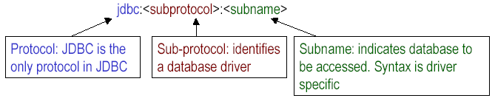
Step 2: Opening a Database Connection
• getConnection method of DriverManager class returns a connection
• When there are several databases used by the same application, the driver required to access the database is uniquely identified using JDBC URLs
JDBC URL: Represents a driver and has following three-part syntax
Examples:
"jdbc:odbc:books” : specifies database books as ODBC data source (books is a logical name linked to actual database)

Slide 13
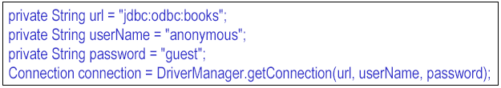
Step 2: Opening a Database Connection(contd.)
• Getting a connection to ODBC data source books (MS Access database)
• DriverManager has other variants of getConnection method that accept different set of parameters
• Connection is an interface defined in java.sql package. A Connection object represents a connection with the database. The interface has methods to create statements which can be used to manipulate the database

Slide 14
Step 3: Creating Statement & executing SQL Statements
• Connection objects can be used to create statement objects.
statement = connection.createStatement();
• Statement is an interface that contains methods for executing SQL queries
• sqlStr contains a string which is an SQL statement for inserting a new record in the table Authors in the books database
• The SQL statement is executed using executeUpdate method of the statement object
• The method is used to execute statements like INSERT, UPDATE, DELETE that do not return any results. It returns number of rows affected
• Authors is one of the tables in the books.mdb database. Books, Quotations, Topics are some of the other fields.
The Authors table consists of four fields
• Authord Id, first name, last name and notes. In the above example, they have the values ’5’ , ‘Walter’, ‘Lippman’ and ‘Journalist’ respectively

Slide 15
Step 4: Enquiring the Database
• The Statement object returns a java.sql.ResultSet object upon executing an SQL statement using executeQuery method
• The method returns all rows in Authors table as a ResultSet
• The next() method of ResultSet allows to move from one row to the next
while (rs.next()) {
// rs stands for a row in each iteration; print author details
}
• ResultSet contains several methods for extracting various fields in a row. The methods require column name or column index as an argument. The method used depends on type of the field. For example, author’s first name can be obtained by
rs.getString( "FirstName" )
FirstName is the name of the field assigned while creating the database. The method returns author’s first name which is a string

Slide 16
Before compiling - Register a database as an ODBC Data Source
• The computer should have Microsoft Access installed
• Invoke ODBC Data Source Administrator:
  In Windows Control Panel, double click “ODBC Data Sources”. • The dialog is used to register user data source name. The tab User DSN must be selected
  • Since a new data source is to be created, click Add in the dialog. Create New Data Source dialog appears.
  • There are several drivers listed in the dialog including dBase, Oracle, Microsoft Access etc. books is a Microsoft Access database. So, select Microsoft Access Driver and click Finish.
  • Another dialog ODBC Microsoft Access Setup appears.
  • In the field Data Source Name enter a name by which the database is to be referred in JDBC program. In the example, the name books is used.
  • This name should be associated with an actual database. Click Select button. This displays Select Database dialog which allows to select a database on the local file system or across the network.
  • Click OK to dismiss the Select Database dialog and return to ODBC Microsoft Access Setup

Slide 17
Registering as an ODBC Data Source
• Click Advanced button in ODBC Microsoft Access Setup dialog. Set Advanced Options dialog appears
• Enter authorisation information Login name and Password. In this example, the login name is anonymous and password is guest
• Click OK to dismiss the dialog
• Dismiss the ODBC Microsoft Access Setup dialog by clicking OK.
• Now ODBC Data Source Administrator dialog contains data source books with Microsoft Access Driver associated with it.
• Now the database can be accessed using JDBC-ODBC bridge driver

Slide 18
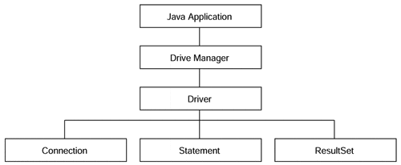
JDBC key components

Slide 19
The DriverManager Object.
Once a driver is installed, you need to load it into your Java object by using the DriverManager. It provides a common interface to a JDBC driver object without having to delve into the internals of the database itself
The driver is responsible for creating and implementing the Connection, Statement, and ResultSet objects for the specific database.
DriverManager then is able to acquire those object implementations for itself. In so doing, applications that are written using the DriverManager are isolated from the implementation details of databases.

Slide 20
Database Connection Interface.
The Connection object is responsible for establishing the link between the Database Management System and the Java application.
It also enables the programmer to select the proper driver for the required application.
The Connection.getConnection method accepts a URL and enables the JDBC object to use different drivers depending on the situation, isolates applets from connection-related information, and gives the application a means by which to specify the specific database to which it should connect. The URL takes the form of jdbc:<subprotocol>:<subname>. The subprotocol is a kind of connectivity to the database

Slide 21
Database Statement Object.
A Statement encapsulates a query written in Structured Query Language and enables the JDBC object to compose a series of steps to look up information in a database.
Using a Connection, the Statement can be forwarded to the database and obtain a ResultSet

Slide 22
ResultSet Access Control.
A ResultSet is a container for a series of rows and columns acquired from a Statement call. Using the ResultSet's iterator routines, the JDBC object can step through each row in the result set. Individual column fields can be retrieved using the get methods within the ResultSet. Columns may be specified by their field name or by their index.

Slide 23
Basic Database operations
public static void main(String[] args) {
String url = "jdbc:odbc:sach";
String userName = "ltmang";
String password = "ltmang";
try {
Class.forName("sun.jdbc.odbc.JdbcOdbcDriver");
Connection connection =
DriverManager.getConnection(url,userName,password);
Statement statement = connection.createStatement();
String sql = "select * from sach";
ResultSet rs = statement.executeQuery(sql);
while (rs.next()) {
System.out.println(rs.getString( "tens" ));
}

Slide 24
Basic Database operations
sql = "insert into sach values('P6','Tu hoc Internet'," +
"'Nha xuat ban lao đong')";
statement.executeUpdate(sql);
sql = "select * from sach";
rs = statement.executeQuery(sql);
while (rs.next()) {
System.out.println(rs.getString( "tens" ));
}
rs.close();
statement.close();
connection.close();
}
catch (Exception e) {
System.out.println( e.getMessage());
}
}

